Slide 1
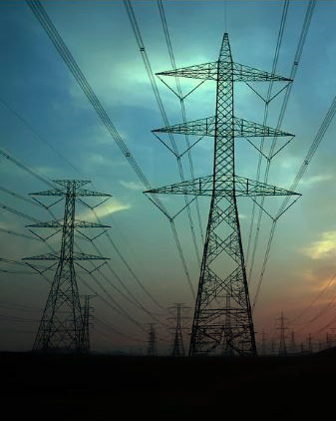

LOAD SHORTFALL PREDICTIONAT 3-HOURLY FREQUENCY FOR SPAIN
THE FANTASTIC 5 DATA SCIENCE TEAM

Slide 2



OUR TEAM
Michael Okereafor
Meleka Victor
Machine Learning Specialist
Model Specialist
Nnamdi Isichei
Techincal Adviser

Slide 3
OUR TEAM
Michael Okereafor
Meleka Victor
Machine Learning Specialist
Model Specialist
Nnamdi Isichei
Techincal Adviser

Slide 4
OUR TEAM
Michael Okereafor
Meleka Victor
Machine Learning Specialist
Model Specialist
Nnamdi Isichei
Techincal Adviser

Slide 5
OUR TEAM
Michael Okereafor
Meleka Victor
Machine Learning Specialist
Model Specialist
Nnamdi Isichei
Techincal Adviser

Slide 6
ORDER OF PRESENTATION
01.
02.
03.
04.
Problem Statement
Introduction
We identified the problem to be solved
Problem presented through storyline
Data Presentation
Data Exploration
We shall discuss about the data and data analysis
Here, we’ll discuss the process of Exploratory Data Analysis
Model Presentation
05.
06.
Conclusion
Present the models deployed for predictions
Conclusion and recommendation will be given here

Slide 7
ORDER OF PRESENTATION
01.
02.
03.
04.
Problem Statement
Introduction
We identified the problem to be solved
Problem presented through storyline
Data Presentation
Data Exploration
We shall discuss about the data and data analysis
Here, we’ll discuss the process of Exploratory Data Analysis
Model Presentation
05.
06.
Conclusion
Present the models deployed for predictions
Conclusion and recommendation will be given here

Slide 8
ORDER OF PRESENTATION
01.
02.
03.
04.
Problem Statement
Introduction
We identified the problem to be solved
Problem presented through storyline
Data Presentation
Data Exploration
We shall discuss about the data and data analysis
Here, we’ll discuss the process of Exploratory Data Analysis
Model Presentation
05.
06.
Conclusion
Present the models deployed for predictions
Conclusion and recommendation will be given here

Slide 9
ORDER OF PRESENTATION
01.
02.
03.
04.
Problem Statement
Introduction
We identified the problem to be solved
Problem presented through storyline
Data Presentation
Data Exploration
We shall discuss about the data and data analysis
Here, we’ll discuss the process of Exploratory Data Analysis
Model Presentation
05.
06.
Conclusion
Present the models deployed for predictions
Conclusion and recommendation will be given here

Slide 10
ORDER OF PRESENTATION
01.
02.
03.
04.
Problem Statement
Introduction
We identified the problem to be solved
Problem presented through storyline
Data Presentation
Data Exploration
We shall discuss about the data and data analysis
Here, we’ll discuss the process of Exploratory Data Analysis
Model Presentation
05.
06.
Conclusion
Present the models deployed for predictions
Conclusion and recommendation will be given here

Slide 11
ORDER OF PRESENTATION
01.
02.
03.
04.
Problem Statement
Introduction
We identified the problem to be solved
Problem presented through storyline
Data Presentation
Data Exploration
We shall discuss about the data and data analysis
Here, we’ll discuss the process of Exploratory Data Analysis
Model Presentation
05.
06.
Conclusion
Present the models deployed for predictions
Conclusion and recommendation will be given here

Slide 12
ORDER OF PRESENTATION
01.
02.
03.
04.
Problem Statement
Introduction
We identified the problem to be solved
Problem presented through storyline
Data Presentation
Data Exploration
We shall discuss about the data and data analysis
Here, we’ll discuss the process of Exploratory Data Analysis
Model Presentation
05.
06.
Conclusion
Present the models deployed for predictions
Conclusion and recommendation will be given here

Slide 13

01.
Problem Statement
The problem statement is identified as follows:

Slide 14
Problem Statement
To keep the lights on and increase the standard of living for its population, the Spanish government is considering raising its renewable energy resource infrastructure investments.
In recent years, evidence has demonstrated that reliance primarily on nonrenewable resources is unsustainable. As a result, the government needs information on the country's renewable and fossil-fuel energy generation trends and patterns, and it has been tracking the various energy sources available inside the country.
Following consultation, the Fantastic5 DataScience Team agreed to model the shortfall between the energy generated by means of fossil fuels and various renewable sources for the country of Spain.

Slide 15

02. Introduction
Imagine a world without electricity…

Slide 16


Slide 17
03. Data Presentation
To avoid such a problem in Spain, the government gathered data on weather conditions in five Spanish cities from 2015 to 2017 which also includes statistics on three hourly load shortfall over the same time period.

Slide 18
Data Presentation
2015
2016
2017
01
02
03
3 hourly Load Shortfall
35233437 MWH
30280324 MWH
28021253 MWH

Slide 19
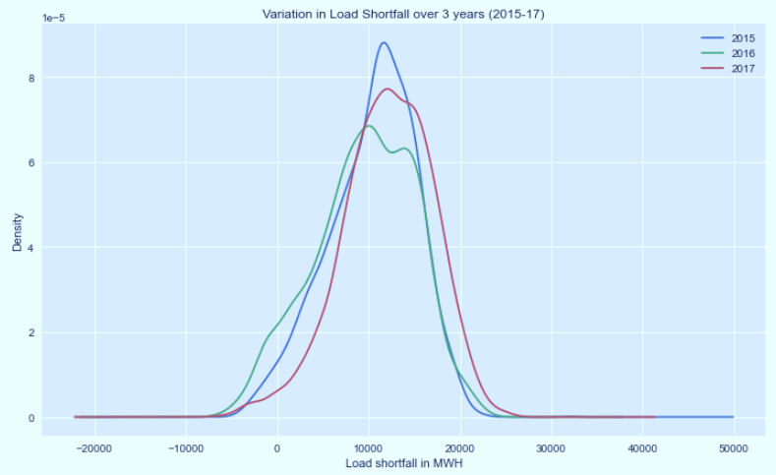
Density plot of load shortfall

Slide 20
Target variable
Load shortfall 3h
Load shortfall
Time

Slide 21
Features
Cloud all
Rain
Wind
Humidity
Snow
Temperature
Pressure

Slide 22
Features
Cloud all
Rain
Wind
Humidity
Snow
Temperature
Pressure

Slide 23
Features
Cloud all
Rain
Wind
Humidity
Snow
Temperature
Pressure

Slide 24
Features
Cloud all
Rain
Wind
Humidity
Snow
Temperature
Pressure

Slide 25
Features
Cloud all
Rain
Wind
Humidity
Snow
Temperature
Pressure

Slide 26
Features
Cloud all
Rain
Wind
Humidity
Snow
Temperature
Pressure

Slide 27
Features
Cloud all
Rain
Wind
Humidity
Snow
Temperature
Pressure

Slide 28
Features
Cloud all
Rain
Wind
Humidity
Snow
Temperature
Pressure

Slide 29
Process flowchat
Importing data
3-Hourly energy data
Data /cleaning/wrangling
Adding features
Merge
EDA
Preparing data for ML models, Feature engineering, define error metrics
ML models training & testing and comparing results

Slide 30
04. Data Exploration (EDA)

Slide 31
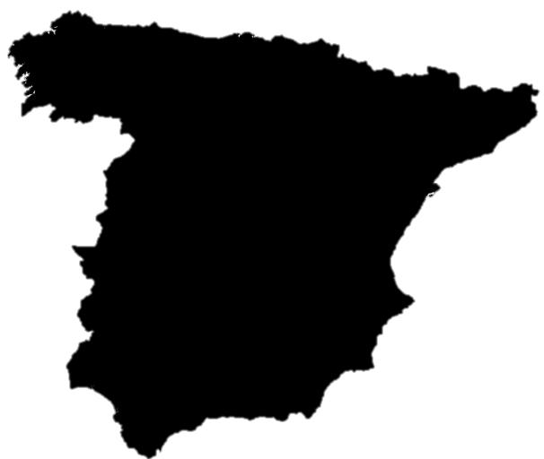
Load shortfall Data
Bercelona
Spain
3 hourly load shortfall
Madrid
Bilbao
Valencia
Seville

Slide 32
Data Cleaning
Data imported
Data cleaning and formatting
Filling null values
Notes:
-Data imported and stored in pandas DataFrame
- Data cleaning and formatting done with the help of data visualization and Descriptive stats.
-The null values were filled with the average values of the matching year, month and weekday for the same hours from the rest of the data.

Slide 33
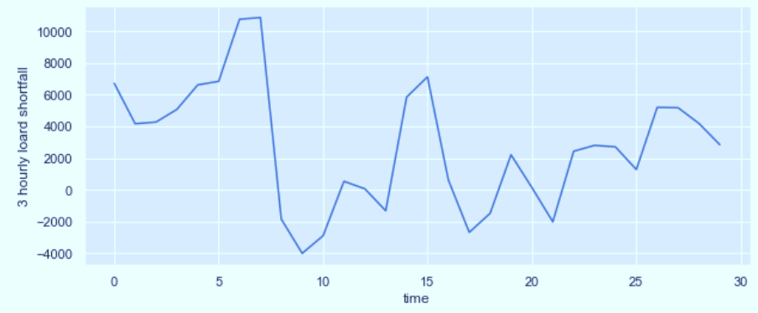
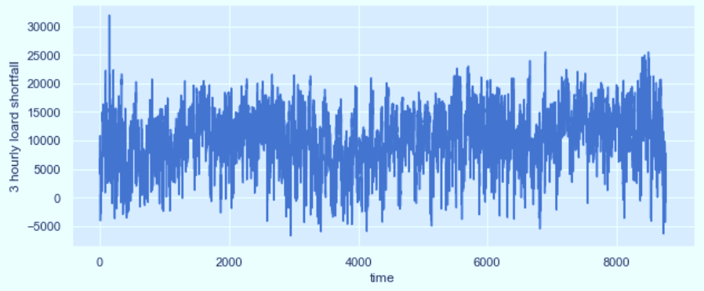
Load shortfall varies with time
91998 hours of data
Load shortfall measured in MWH
Mean: 10673.86
Median: 11114.67
Min: -6618.00
Max: 31904.00

Slide 34
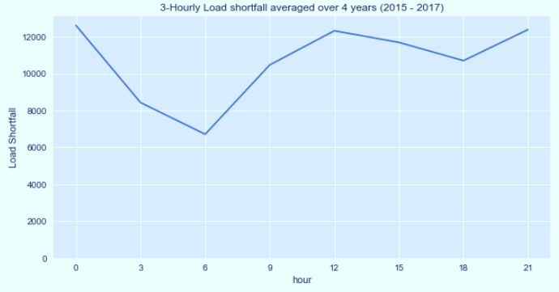
3 Hourly Variation of Load Shortfall

Slide 35
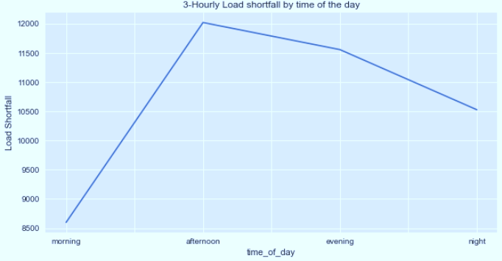
Variation by time of day

Slide 36
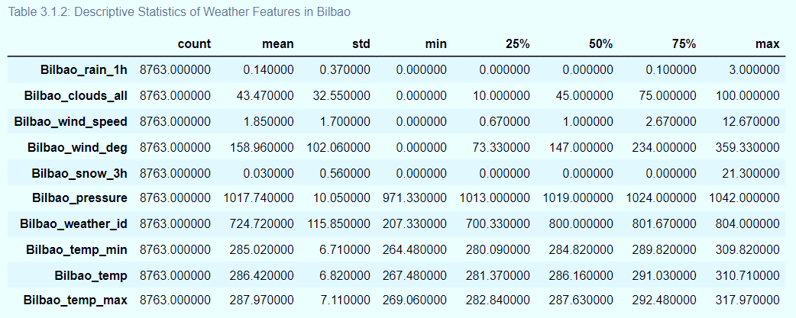
Grouping weather features by cities

Slide 37
Cities with similar weather features
S/N | Cities | Similar features
1. | Barcelona, Bilbao, Madrid, Seville, Valencia | wind_speed, temp
2. | Barcelona, Bilbao, Madrid, Valencia | pressure
3. | Madrid, Seville, Valencia | humidity
4. | Bilbao, Madrid, Seville | clouds_all
5. | Barcelona, Bilbao, Madrid, Seville | rain_1h
6. | Barcelona, Seville | rain_3h
7. | Bilbao, Valencia | snow_3h

Slide 38
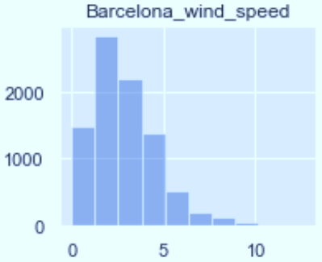
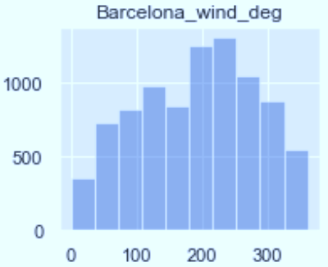
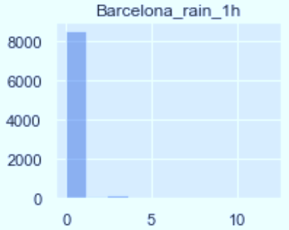
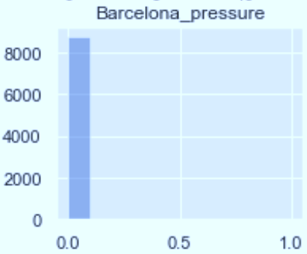
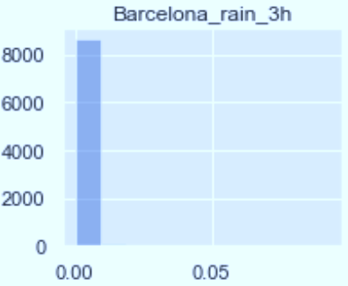
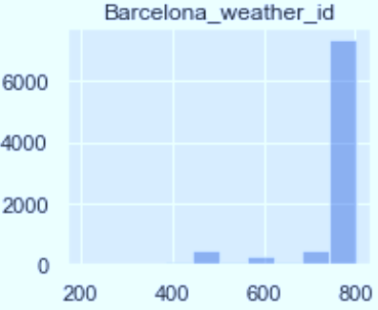
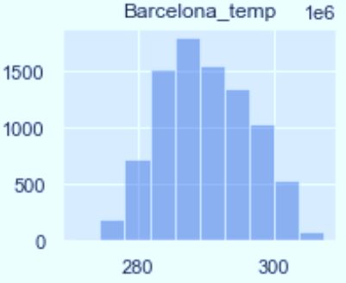

Hypothesis 1
$H_{0}$: There is no relationship in the trend between the weather features from various cities.

Slide 39
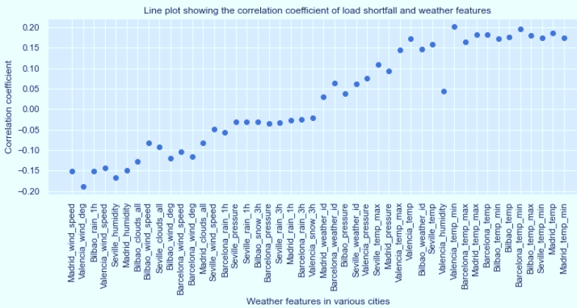

Hypothesis 2
$H_{0}$: There is no relationship between the target variable (load shortfall) and the predictors.

Slide 40
Data cleaing and feature Engineering

Slide 41
Data cleaning/engineering proceedure
Missing values in Valencia pressure was replaced with mean()
Convert time feature with object datatype to numeric datatype
Breaking down the time feature in to different features such as Year, Month, Day etc
Removing unnecessary column(s)
Removing correlated column(s)
Removing outliers for some features(Scaling)

Slide 42

05. Model Presentation

Slide 43
Load shortfall 3h
Why time series?
Our target variable is a time series data hence requires some time series model.
It’s time series because it’s a sequence of observations taken sequentially in time with the following components:
Trend
Seasonality
Irregularity

Slide 44
Load shortfall 3h
Why time series?
Our target variable is a time series data hence requires some time series model.
It’s time series because it’s a sequence of observations taken sequentially in time with the following components:
Trend
Seasonality
Irregularity

Slide 45
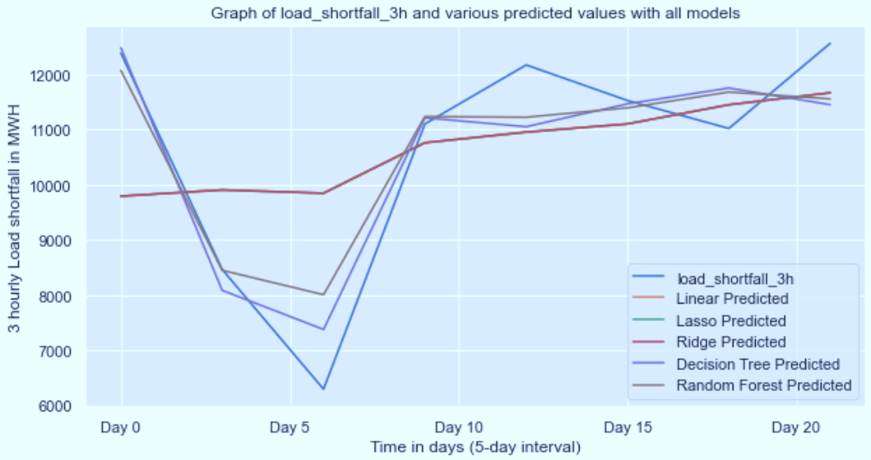
Model Exploration

Slide 46
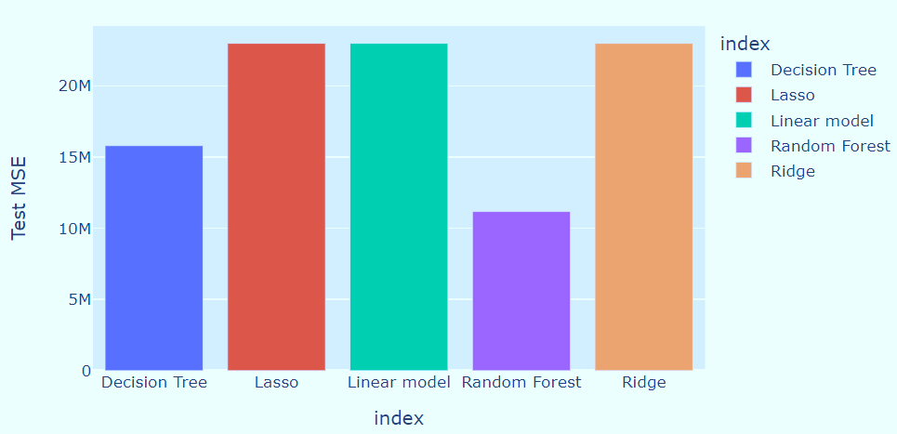
Model Performance – MSE Test

Slide 47
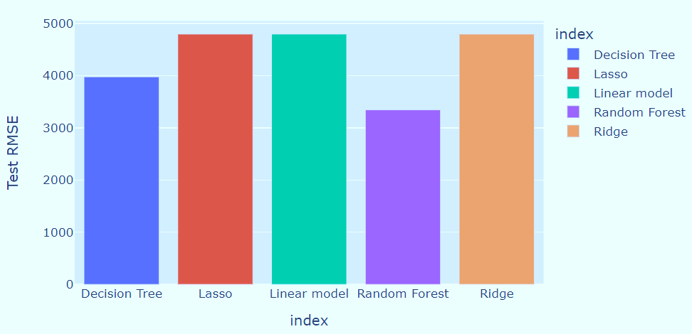
Model Performance – RSME Test

Slide 48
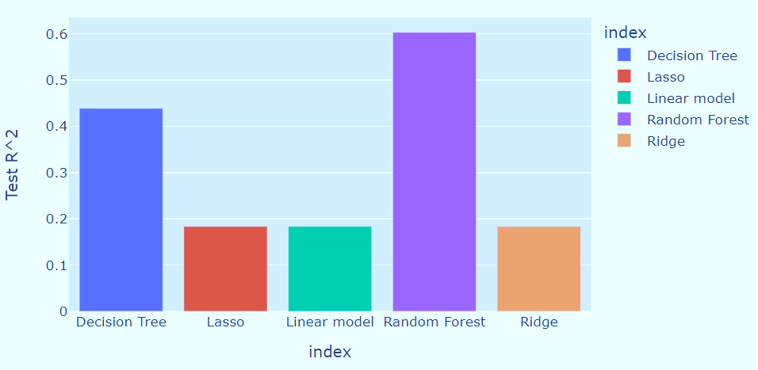
Model Performance – $R^{2}$ Score

Slide 49
Conclusion
Project 1
Project 3
Venus is the second planet from the Sun
Mercury is the closest planet to the Sun
01
02
03
04
Project 2
Project 4
Despite being red, Mars is a cold place
Jupiter is the biggest planet of them all

Slide 50

THANKS
Do you have any questions?
info@fantastic5consult.com
+91 620 421 88
www.fantastic5constult.com
Please keep this slide for attribution

